Slide 1
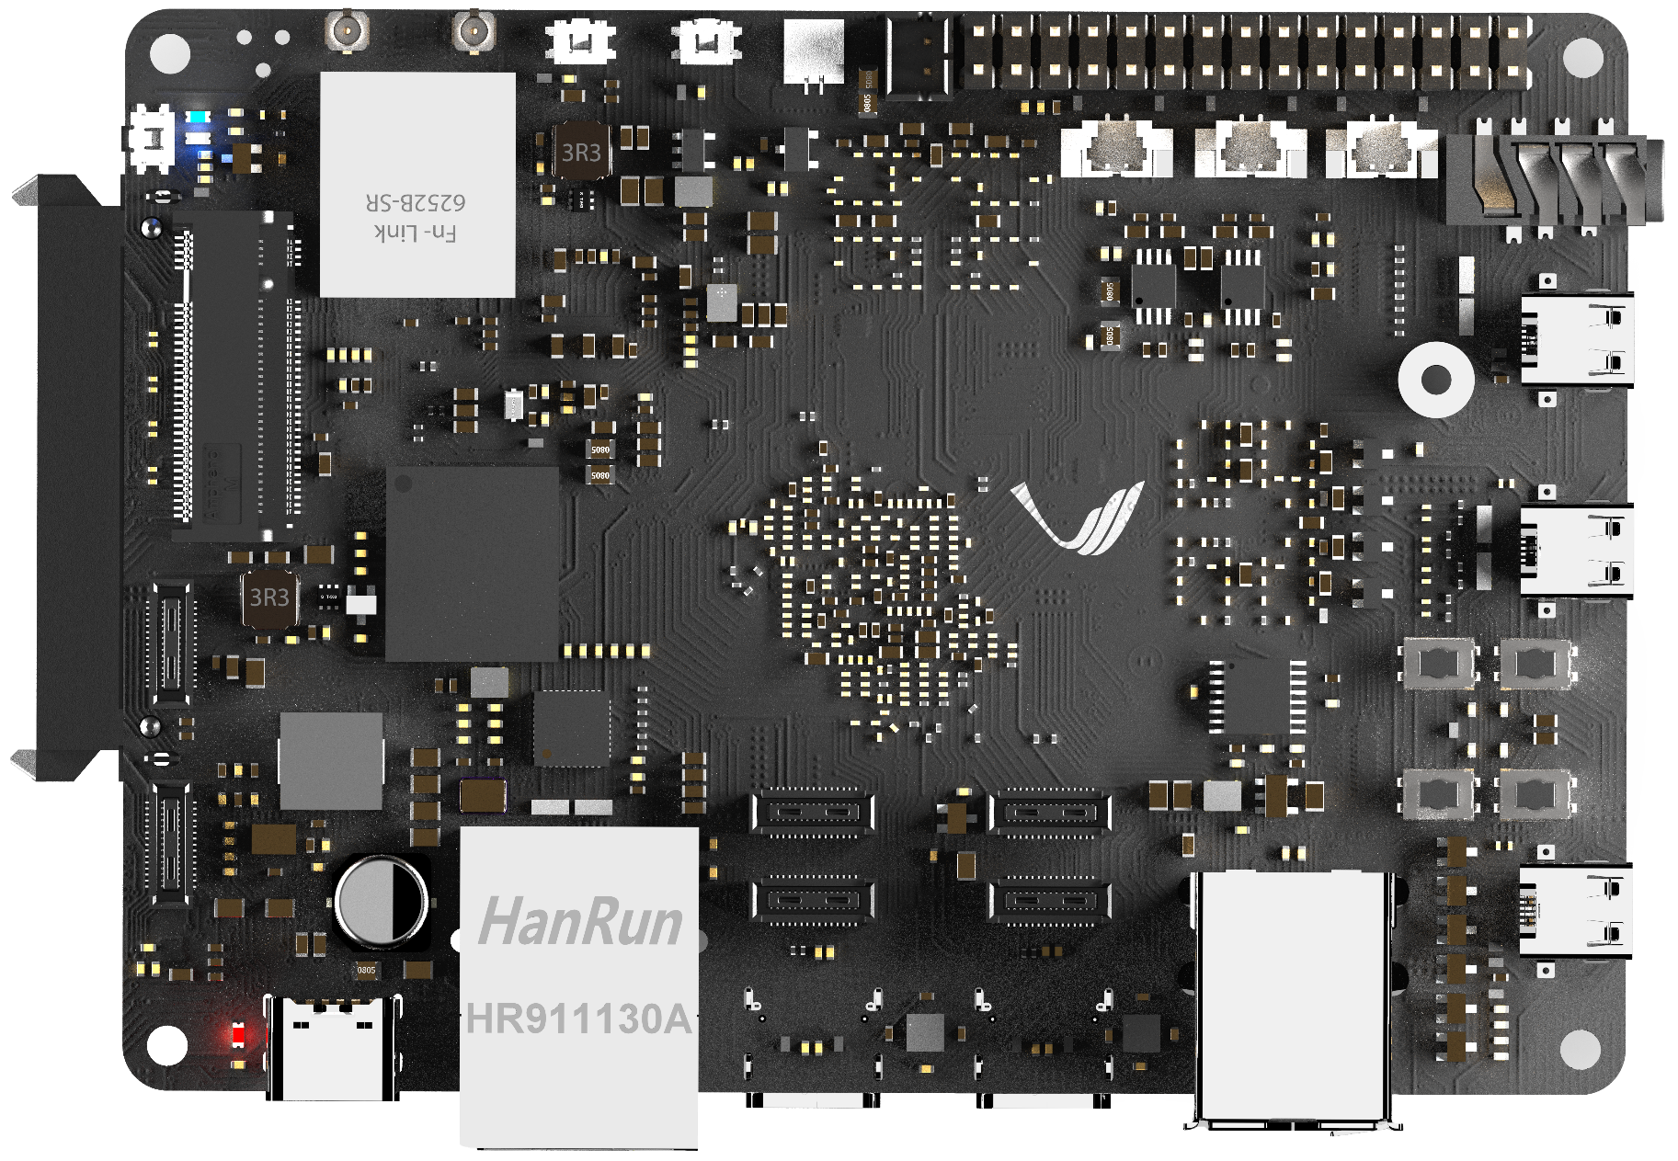
RTC Battery
Fan
18
17
2 X Analog Speaker
Reset & Power Key
15
19
WIFI6 & BT5.2
16
1 X 30 pin GPIO header
20
15
1 X Analog MIC
01
Maskrom Key
3.5mm Audio Jack
14
02
LEDs
03
NVMe M.2 M-Key
13
1 X HDMI IN
04
MIPI CSI RX0
13
2 X HDMI OUT
05
MIPI CSI RX1
Power LED
06
1x Type-C PD
12V Input
07
1x RJ45
12
2x USB2.0
MIPI D-PHY TX0
08
MIPI D-PHY RX1
11
MIPI D-PHY TX1
09
10
MIPI D-PHY RX0
TOP SIDE

Slide 2
21
2 X PCIE Gen 2.0/SATA3.0
(40 Pin FPC Connector)
1 X SATA3.0 (22 pin Standard
SATA Connector)
24
22
SD Card Slot
23
2 X Type-C Alt Display Port
BOTTOM SIDE

Slide 3
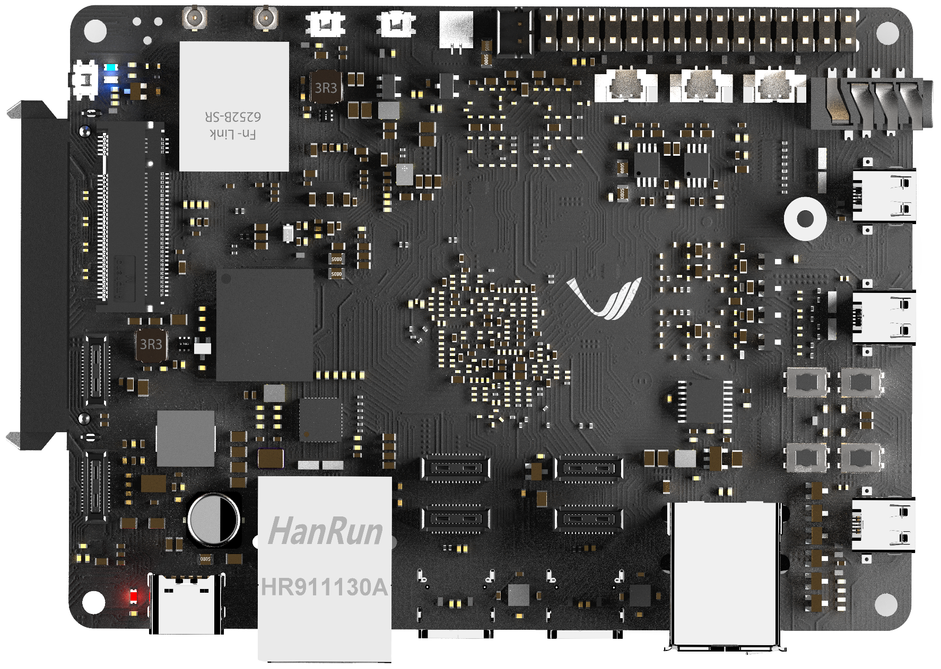
01
Maskrom key
Maskrom Key

Slide 4
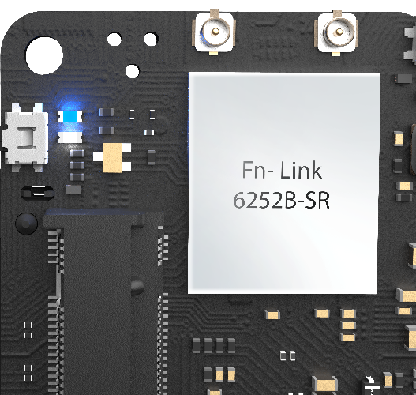
02
LEDs
1.User LED
2. Status LED

Slide 5
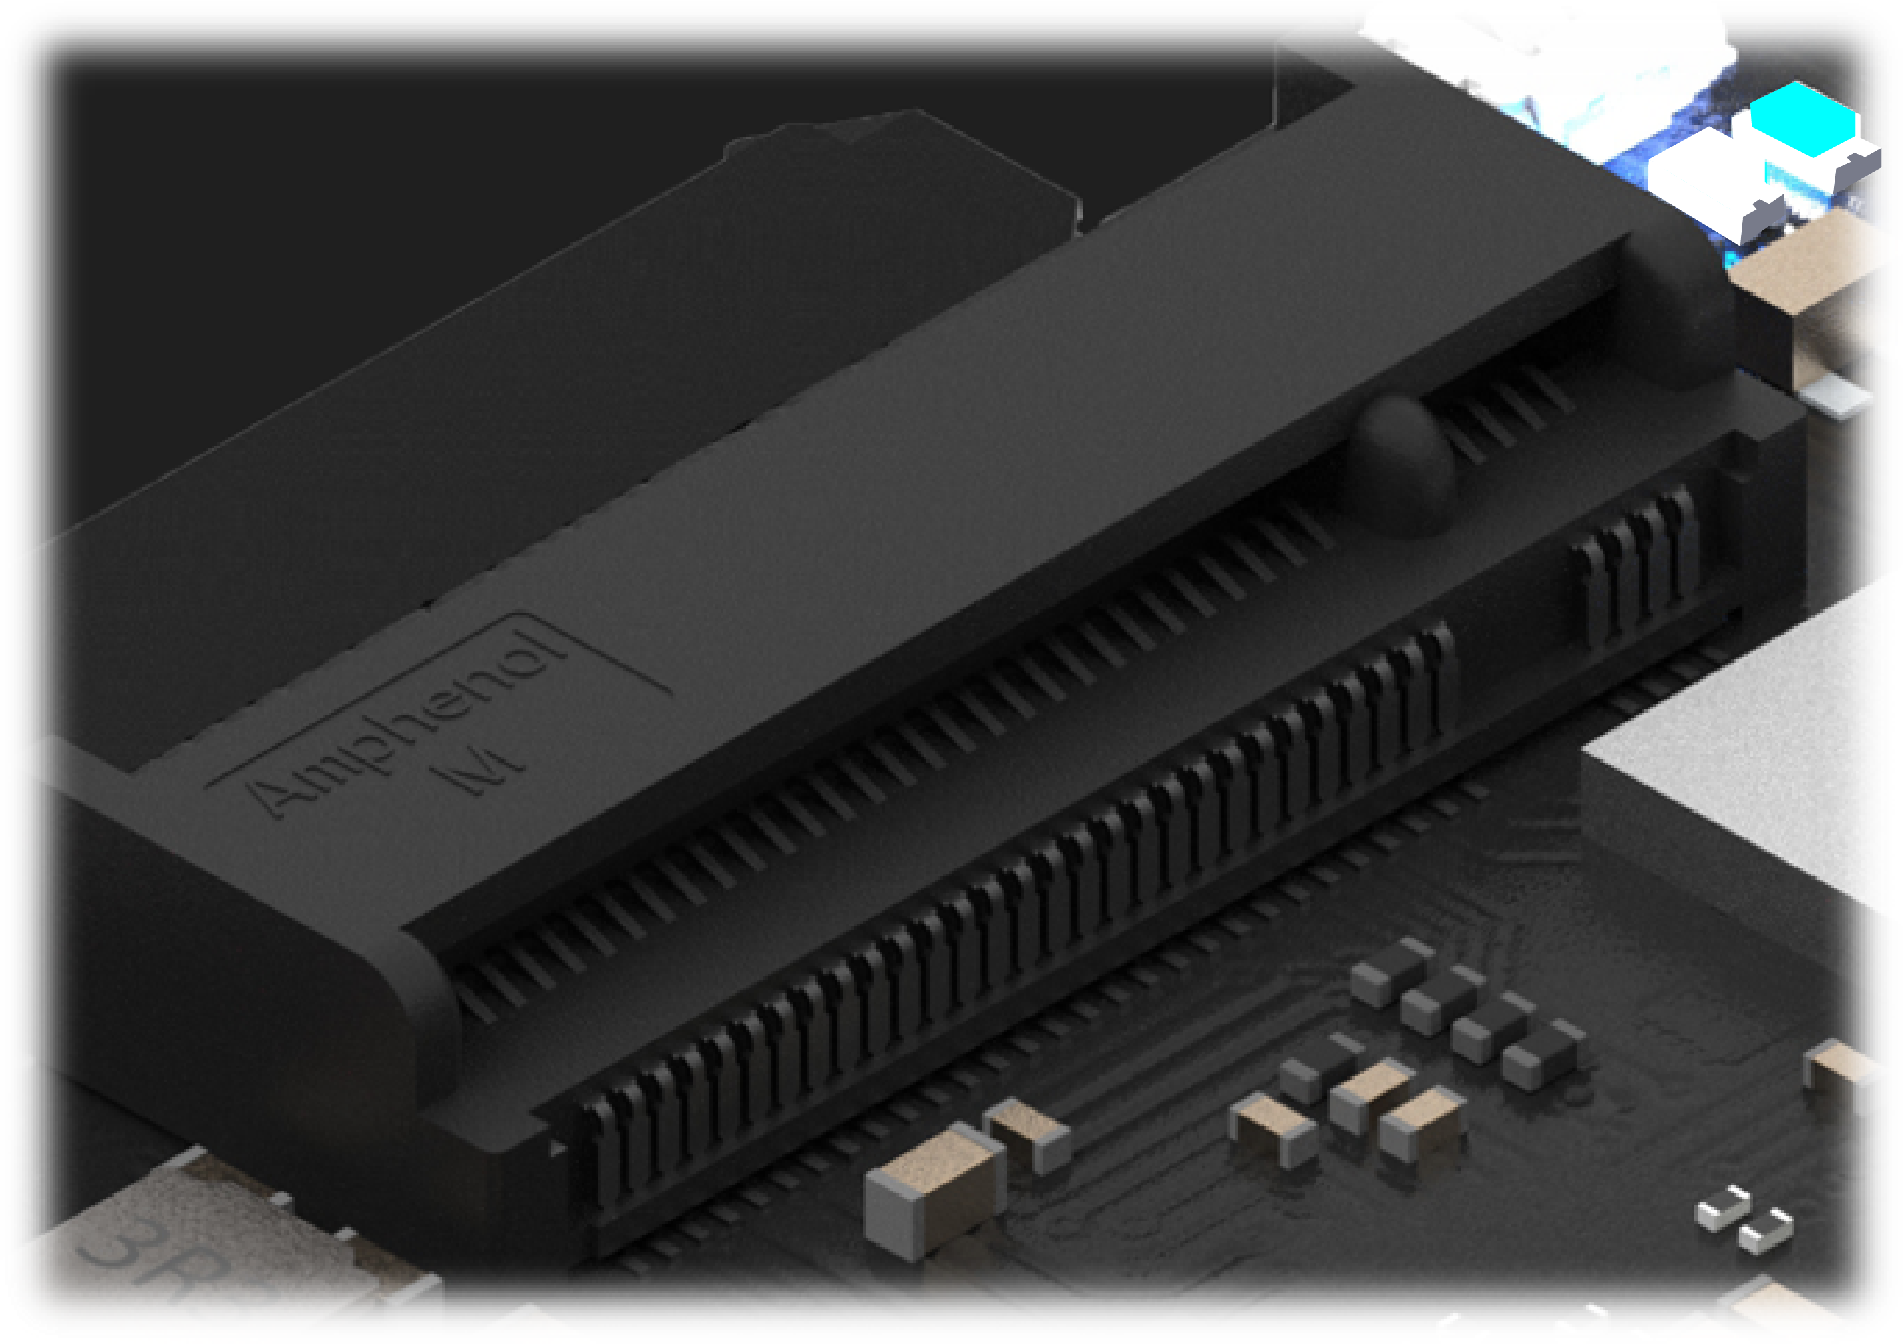
03
NVME M.2 M-key Connector
NVME M.2 M-Key
PCIe Gen3

Slide 6
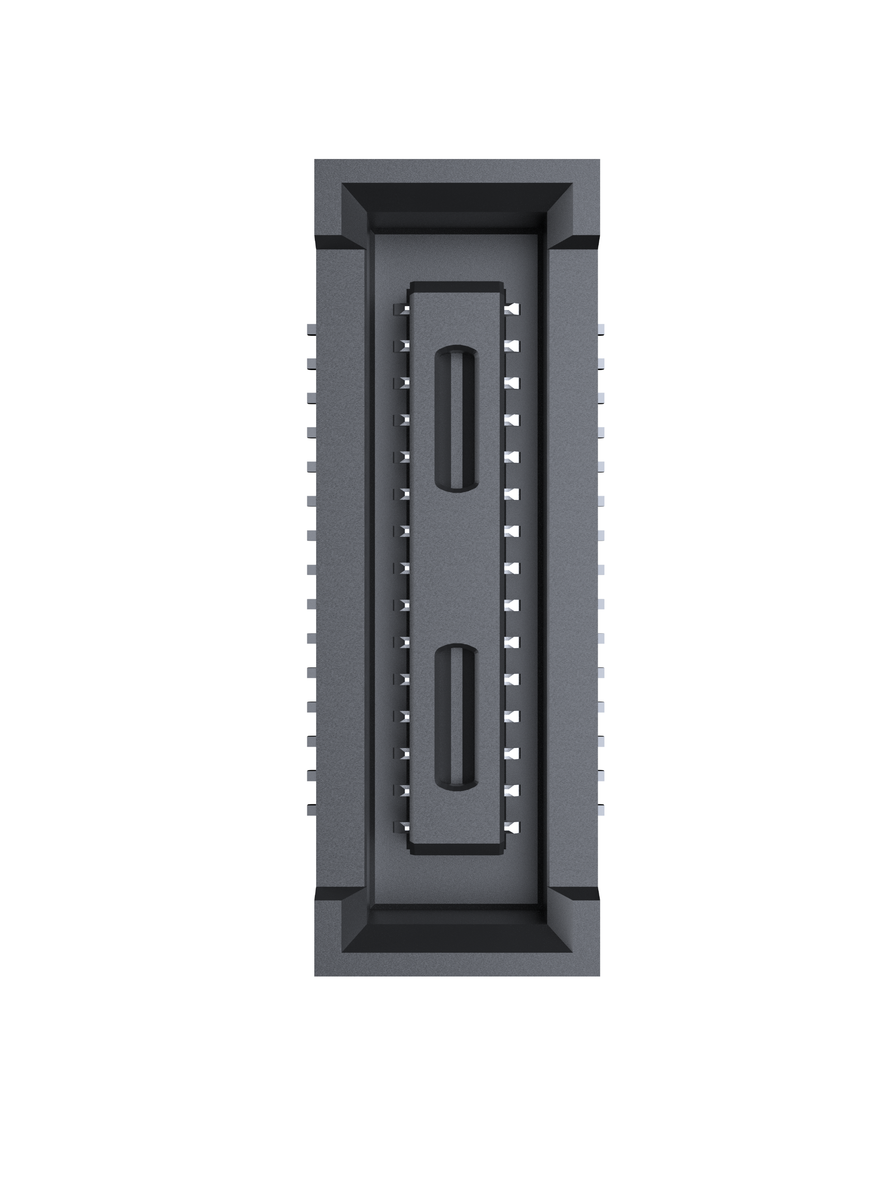
04
MIPI CSI RX PORT0
GND
01
02
MIPI_CSI0_RX_CLK0_N
MIPI_CSI0_RX_D0_P
03
04
MIPI_CSI0_RX_CLK0_P
MIPI_CSI0_RX_D0_N
05
06
GND
GND
07
08
MIPI_CSI0_RX_D2_N
MIPI_CSI0_RX_D1_N
09
10
MIPI_CSI0_RX_D2_P
MIPI_CSI0_RX_D1_P
11
12
GND
GND
13
14
MIPI_CSI0_RX_D3_N
MIPI_CSI0_RX_CLK1_N
15
16
MIPI_CSI0_RX_D3_P
MIPI_CSI0_RX_CLK1_P
17
18
GND
GND
19
20
VCC_3V3_CSI
I2C3_SDA_M0
21
22
VCC_3V3_CSI
I2C3_SCL_M0
23
24
VCC_3V3_CSI
MIPI_CAM3_PDN_L
25
26
VCC_3V3_CSI
MIPI_CAM3_RESET_L
27
28
GND
MIPI_CAM3_CLKOUT
29
30
GND
On-Board Connector 30 Pin 0.4mm Pitch
MPN : DF40HB(2.0)-30DS-0.4V(51)
MIPI CSI RX0
Mating Connector 30 Pin 0.4mm Pitch
MPN : DF40C-30DP-0.4V(51)

Slide 7
05
MIPI CSI RX PORT1
GND
01
02
MIPI_CSI0_RX_CLK0_N
MIPI_CSI0_RX_D0_P
03
04
MIPI_CSI0_RX_CLK0_P
MIPI_CSI0_RX_D0_N
05
06
GND
GND
07
08
MIPI_CSI0_RX_D2_N
MIPI_CSI0_RX_D1_N
09
10
MIPI_CSI0_RX_D2_P
MIPI_CSI0_RX_D1_P
11
12
GND
GND
13
14
MIPI_CSI0_RX_D3_N
MIPI_CSI0_RX_CLK1_N
15
16
MIPI_CSI0_RX_D3_P
MIPI_CSI0_RX_CLK1_P
17
18
GND
GND
19
20
VCC_3V3_CSI
I2C3_SDA_M0
21
22
VCC_3V3_CSI
I2C3_SCL_M0
23
24
VCC_3V3_CSI
MIPI_CAM3_PDN_L
25
26
VCC_3V3_CSI
MIPI_CAM3_RESET_L
27
28
GND
MIPI_CAM3_CLKOUT
29
30
GND
On-Board Connector 30 Pin 0.4mm Pitch
MPN : DF40HB(2.0)-30DS-0.4V(51)
MIPI CSI RX1
Mating Connector 30 Pin 0.4mm Pitch
MPN : DF40C-30DP-0.4V(51)

Slide 8
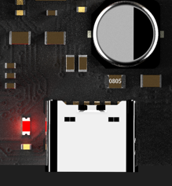
06
Type-C PD (12V Input) & PWR LED
PWR
LED
Type-C Power Input (12VDC-5A)

Slide 9
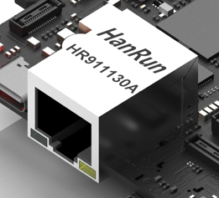
07
ETHERNET
ETHERNET
(10/100/1000Mbps)

Slide 10
08
MIPI D-PHY TX PORT0
GND
01
02
MIPI_DPHY0_TX_D3_P
MIPI_DPHY0_TX_D2_P
03
04
MIPI_DPHY0_TX_D3_N
MIPI_DPHY0_TX_D2_N
05
06
GND
GND
07
08
MIPI_DPHY0_TX_CLK_P
MIPI_DPHY0_TX_D1_N
09
10
MIPI_DPHY0_TX_CLK_N
MIPI_DPHY0_TX_D1_P
11
12
GND
GND
13
14
GND
MIPI_DPHY0_TX_D0_N
15
16
GND
MIPI_DPHY0_TX_D0_P
17
18
GND
GND
19
20
VCC_3V3_MIPI_TX
TP_RST_L_0
21
22
VCC_3V3_MIPI_TX
TP_INT_L_0
23
24
VCC_3V3_MIPI_TX
I2C5_SCL_M0_TP
25
26
VCC_3V3_MIPI_TX
I2C5_SDA_M0_TP
27
28
LCD_BL_EN_0
LCD_BL_PWM1
29
30
GND
On-Board Connector 30 Pin 0.4mm Pitch
MPN : DF40HC(3.5)-30DS-0.4V(51)
MIPI DPHY TX0
Mating Connector 30 Pin 0.4mm Pitch
MPN : DF40C-30DP-0.4V(51)

Slide 11
09
MIPI D-PHY TX PORT1
GND
01
02
MIPI_DPHY1_TX_D2_P
MIPI_DPHY1_TX_D3_P
03
04
MIPI_DPHY1_TX_D2_N
MIPI_DPHY1_TX_D3_N
05
06
GND
GND
07
08
MIPI_DPHY1_TX_CLK_P
MIPI_DPHY1_TX_D1_P
09
10
MIPI_DPHY1_TX_CLK_N
MIPI_DPHY1_TX_D1_N
11
12
GND
GND
13
14
GND
MIPI_DPHY1_TX_D0_P
15
16
GND
MIPI_DPHY1_TX_D0_N
17
18
GND
GND
19
20
VCC_3V3_MIPI_TX
TP_RST_L_1
21
22
VCC_3V3_MIPI_TX
TP_INT_L_1
23
24
VCC_3V3_MIPI_TX
I2C5_SCL_M0_TP
25
26
VCC_3V3_MIPI_TX
I2C5_SDA_M0_TP
27
28
LCD_PWREN_1
LCD_BL_PWM2
29
30
GND
On-Board Connector 30 Pin 0.4mm Pitch
MPN : DF40HB(2.0)-30DS-0.4V(51)
MIPI DPHY TX1
Mating Connector 30 Pin 0.4mm Pitch
MPN : DF40C-30DP-0.4V(51)

Slide 12
10
MIPI D-PHY RX PORT0
GND
01
02
MIPI_DPHY0_RX_D2_P
MIPI_DPHY0_RX_D3_P
03
04
MIPI_DPHY0_RX_D2_N
MIPI_DPHY0_RX_D3_N
05
06
GND
GND
07
08
MIPI_DPHY0_RX_CLK_P
MIPI_DPHY0_RX_D1_P
09
10
MIPI_DPHY0_RX_CLK_N
MIPI_DPHY0_RX_D1_N
11
12
GND
GND
13
14
GND
MIPI_DPHY0_RX_D0_P
15
16
GND
MIPI_DPHY0_RX_D0_N
17
18
GND
GND
19
20
VCC_3V3_MIPI_TX
MIPI_CAM2_CLKOUT
21
22
VCC_3V3_MIPI_TX
MIPI_CAM1/2_RESET_L
23
24
VCC_3V3_MIPI_TX
MIPI_CAM2_PDN_L
25
26
VCC_3V3_MIPI_TX
I2C2_SCL_M4_MIPI
27
28
GND
I2C2_SDA_M4_MIPI
29
30
GND
On-Board Connector 30 Pin 0.4mm Pitch
MPN : DF40HB(2.0)-30DS-0.4V(51)
MIPI DPHY RX0
Mating Connector 30 Pin 0.4mm Pitch
MPN : DF40C-30DP-0.4V(51)

Slide 13
11
MIPI D-PHY RX PORT1
GND
01
02
MIPI_DPHY1_RX_D1_N
MIPI_DPHY1_RX_D3_P
03
04
MIPI_DPHY1_RX_D1_P
MIPI_DPHY1_RX_D3_N
05
06
GND
GND
07
08
MIPI_DPHY1_RX_D0_N
MIPI_DPHY1_RX_D2_P
09
10
MIPI_DPHY1_RX_D0_P
MIPI_DPHY1_RX_D2_N
11
12
GND
GND
13
14
GND
MIPI_DPHY1_RX_CLK_P
15
16
GND
MIPI_DPHY1_RX_CLK_N
17
18
GND
GND
19
20
VCC_3V3_MIPI_TX
MIPI_CAM1_CLKOUT
21
22
VCC_3V3_MIPI_TX
MIPI_CAM1/2_RESET_L
23
24
VCC_3V3_MIPI_TX
MIPI_CAM1_PDN_L
25
26
VCC_3V3_MIPI_TX
I2C2_SCL_M4_MIPI
27
28
GND
I2C2_SDA_M4_MIPI
29
30
GND
On-Board Connector 30 Pin 0.4mm Pitch
MPN : DF40HC(3.5)-30DS-0.4V(51)
MIPI DPHY RX1
Mating Connector 30 Pin 0.4mm Pitch
MPN : DF40C-30DP-0.4V(51)

Slide 14
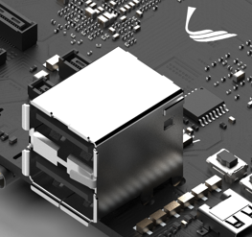
12
Dual USB2.0 HOST
2x USB2.0 HOST

Slide 15
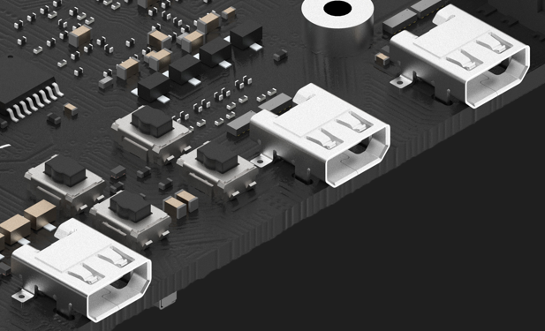
13
HDMI
2x HDMI TX
HDMI RX

Slide 16
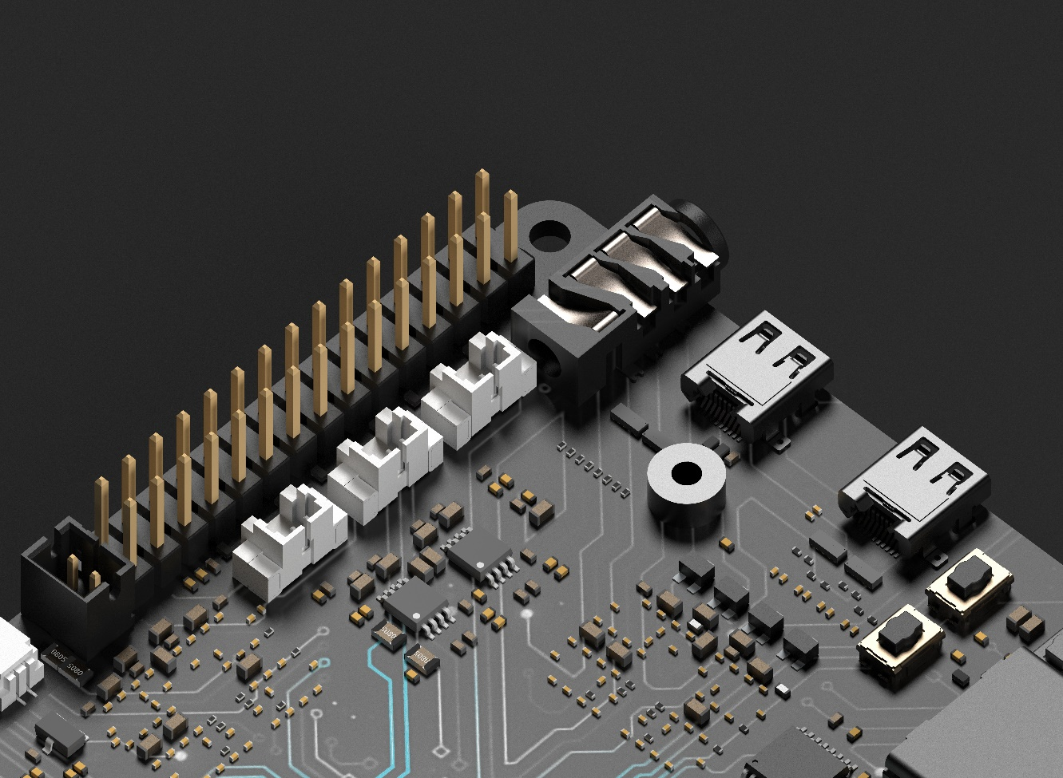
14
Audio Jack
3.5mm Audio Jack with MIC

Slide 17
15
Analog Mic and Speaker
SPK_L
SPK_R
Analog MIC

Slide 18
16
RK3588 GPIOs
12V
01
02
GPIO0_B6
UART2_RX_M0__DEBUG
14
GND
03
04
GPIO0_B5
UART2_TX_M0__DEBUG
13
5V
05
06
GND
5V
07
08
GND
81
GPIO2_C1
09
10
GPIO2_B6
78
80
GPIO2_C0
12
12
GPIO2_B7
79
GND
13
14
3.3V
Note :
GND
15
16
3.3V
GPIO Pin Number
56
GPIO1_D0
17
18
GPIO1_D1
57
59
GPIO1_D3
19
20
GPIO1_D2
58
GND
21
22
3.3V
43
81
GPIO1_B3
23
24
GND
GND
25
26
GND
SARADC_4
27
28
SARADC_3
SARADC_1
29
30
SARADC_2
RK3588 30Pin GPIO Header 2.54mm

Slide 19
17
DC FAN Connector
Fan Connector : 2.0mm Pitch

Slide 20
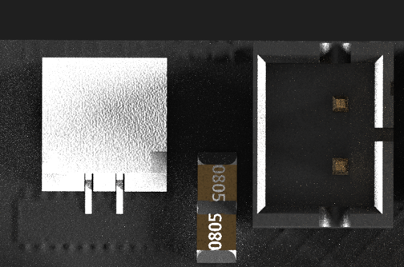
18
RTC Battery Connector
RTC Battery Connector

Slide 21
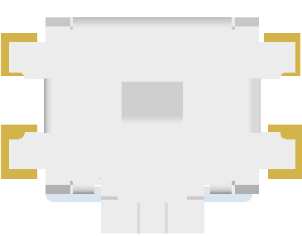
19
Reset & Power Key
PWR
on/off
Key
Reset Key

Slide 22
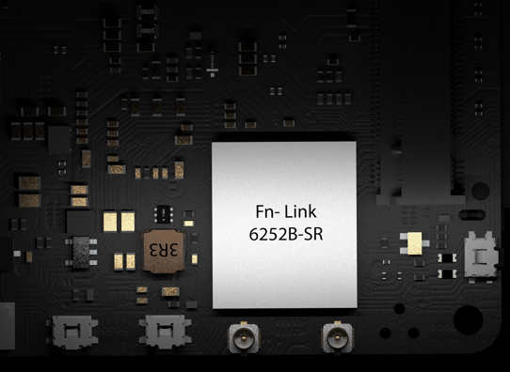
20
WIFI Module
WIFI
WIFI/BT
6252B-SR Wifi6 BT5.2 Module

Slide 23
21
PCIE GEN/SATA3.0 FPC CONNECTOR
01
GND
02-07
VCC_3.3V
08-12
GND
13
PCIE_PWREN_H
14
GND
15
PCIEx1_1_CLKREQn_M1_L
16
PCIEx1_1_WAKEn_M1_L
17
PCIEx1_1_PERSTn_M1_L
18
GND
19
PCIEX1_2_CLKREQn_M1_L
20
PCIEX1_2_WAKEn_M1_L
21
PCIEX1_2_PERSTn_M1_L
22
GND
23
PCIE20_1_TX/SATA30_1_TX_P
24
PCIE20_1_TX/SATA30_1_TX_N
25
GND
26
PCIE20_1_RX/SATA30_1_RX_P
27
PCIE20_1_RX/SATA30_1_RX_N
28
GND
29
PCIE20_1_REFCLK_P
30
PCIE20_1_REFCLK_N
31
GND
32
PCIE20_2_RX/SATA30_2_RX_P
33
PCIE20_2_RX/SATA30_2_RX_N
34
GND
35
PCIE20_2_TX/SATA30_2_TX_P
36
PCIE20_2_TX/SATA30_2_TX_N
37
GND
38
PCIE20_2_REFCLK_P
39
PCIE20_2_REFCLK_N
40
GND
PCIe2.0/SATA3.0 FPC Connector
FPC Connector 40 Pin 0.5mm Pitch
MPN : FPC-05FB-40PH20
FPC Cable 40 Pin 0.5mm Pitch
Impedance 85 Ohm

Slide 24
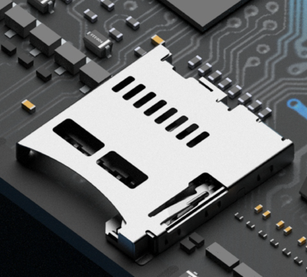
22
MicroSD Card
Push-Push Type MicroSD Card Slot

Slide 25
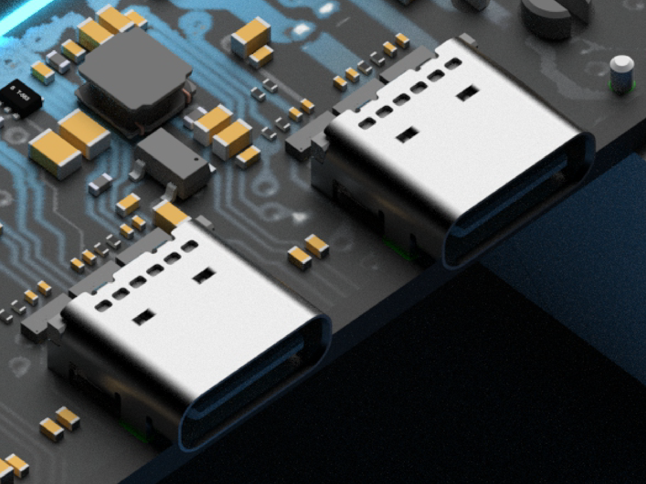
23
USB TYPE-C
TYPE-C Alt Display Port

Slide 26
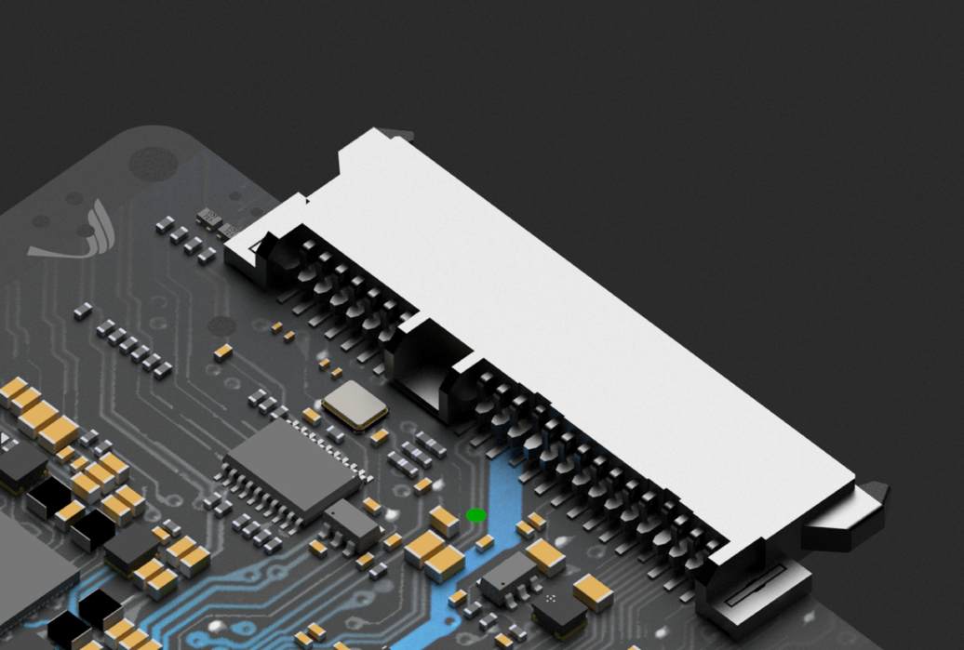
24
SATA 3.0
22 Pin SATA Connector
SATA 3.0

